Slide 1
Java EE – Data Source Layer

Slide 2
Data Source Layer
Communication with databases, messaging systems, transaction managers, other packages or external systems
We’re going to focus on (relational) databases.

Slide 3
Data source patterns

Slide 4
Pattern categories mapped to layers
Web Presentation Patterns
Session State Patterns
Data Transfer Object (DTO)
Remote Facade
Presentation
Domain
Data Source
Domain Model
Service Layer
Layer Supertype
Distribution Patterns
Domain Logic
Patterns
Data Mapper
Identity Map
Separated Interface
Offline Concurrency Patterns
Data Source Architectural Patterns
Object-Relational … Patterns
Notes:
De patterns in de zwarte blokjes gaan we actief gebruiken. Alleen kort opsommen voor een globale indruk van de studenten, later in detail bespreken als we per laag gaan realiseren.

Slide 5
Motivation
Most software systems require persistent data (i.e. data that persists between program executions).
In general, distributing low-level data access logic throughout a program is not a good idea (design).
Program
select * from Items
rs.getString("Name")
Data
Notes:
“Data is a major element in the foundation of any enterprise.”
“Applications need to work with multiple database products.
User interfaces need to hide obscure database semantics.
Data access details make application code difficult to develop and maintain.
Applications need to cache data that they access frequently.”
“Data access patterns describe generic strategies for solving common design problems”
“A pattern does not necessarily dictate a particular implementation. Instead, it describes an effective
design and structure that form the basis for a solution.”
Decoupling patterns: “describes patterns that decouple data access code from other
application logic, resulting in cleaner application code that is less susceptible to defects caused
by changes that relate only to data access details.”
“Nearly every enterprise application is backed by persistent data. An application's data is often worth
considerably more to its users than the application itself. The majority of many systems' resources
are dedicated to implementing and managing data access details and logistics. For this reason, it
is important to understand both your data's structure and application's interactions with it in detail
so you can tune both for efficiency and maintainability.”
“Data access code
that is spread across many components is difficult to change and optimize, let alone comprehend.
Data access code is best left encapsulated within a small number of components so that it is more
maintenance-friendly.”
“Creating enterprise software requires two distinct types of expertise. First, developers must be
intimately acquainted with the application domain. An application domain includes objects and logic
that accurately model business concepts and processes. Creating an effective business application
requires you to understand what data is involved, the relationships among the data, and what expert
users expect to do with it. It is painfully obvious when an application is not designed by domain
experts because it forces users into unnatural paradigms.
The second expertise required to develop enterprise software is the ability to write efficient and
transparent middleware. The term “middleware” refers to the plumbing between application code
and the system. Examples of middleware are system resource libraries, prefabricated graphical user
interface (GUI) components, and database drivers. In addition, you can consider any code that you
write that acts as a conduit between an application and these libraries to be middleware as well.
Writing efficient, maintainable middleware code requires extensive knowledge of database resources and libraries.
These specialties differ in a few regards. Developers with application domain expertise usually attain
their skill through industrial experience, while middleware experts learn from professional training
and documentation. It is uncommon to find programmers with both skill sets. Most middleware programmers
are not able to design a truly marketable business application. Conversely, many business application
developers do not write efficient middleware code.”
“Beginning programmers tend to tackle concrete problems with specific solutions. The resulting code
precisely addresses the immediate needs of their customers and requirements. As projects progress
and programmers gain experience, they learn how to factor common code and designs into mod-
ules.
Modules are a form of software abstraction. Software abstraction is the process of making a solution
to a specific problem useful in a broader scope. As you abstract a specific solution, you focus on
the solution's distinctive characteristics while decoupling it from other components in the system
[Booch 1994]. This concentrated focus simplifies complex solutions because it deemphasizes the
interactions with other objects. Software abstraction usually leads to more effective and reusable
designs and code. Done well, abstractions and reuse significantly reduce overall software
development and maintenance costs.”
Two levels of decoupling: decouple from DB details and decouple from middleware you write.

Slide 6
Data Access Layer
A better design is one that includes a data access layer which encapsulates the details of the underlying persistence API.
It abstracts the low-level details of persistent storage.
It provides an interface that is usually a better match for the style of programming used in the domain logic. For example, the data access layer might provide an OO interface onto relational data.
Notes:
bridging the “impedance mismatch”

Slide 7
Program
Program
customer = dao.find(id)
update(customer)
select * from Items
rs.getString("Name")
Data Access Layer
select * from Items
rs.getString("Name")
Data
Data
Notes:
encapsulates the details of the underlying persistence API

Slide 8
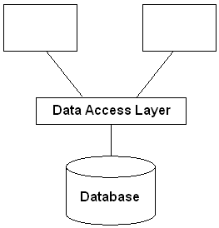
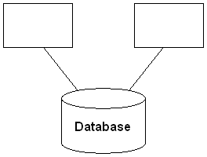
Data Access Layer
To avoid problems associated with mixing SQL and application logic, SQL statements and data base design details are often encapsulated in a data access layer
The data access layer presents an interface that is convenient for application programs.

Slide 9
SQL
Most software systems that need persistent storage more powerful than a flat file end up using a relational database management system
SQL is the standard language for managing data in a relational database.
Mixing SQL with application logic is considered poor design.
Writing simple SQL statements takes a fair amount of skill, and writing efficient SQL statements takes even more. If you mix SQL and application logic, it makes it harder for those unskilled in SQL to work with the code.
Changes to the database may necessitate changes to the SQL that accesses the database. If the SQL is spread throughout the program, a small change to the database might cause a strong ripple effect throughout the program.
Notes:
For most applications, the data access layer will encapsulate SQL logic.

Slide 10
General benefits of having a data access layer
Separation of concerns. Data storage logic is kept separate from domain logic.
Information hiding. Domain logic avoids dependencies on database schema.
Ability to change DB vendors without disrupting client code.
Notes:
Provides object-oriented view of persistent data.
Encapsulates database schemas
“A layer of DAOs makes it easier for an application to migrate to a different
database implementation. The clients have no knowledge of the underlying
data store implementation. Thus, the migration involves changes only to the
DAO layer”
“Reduces code complexity in clients
Since the DAOs encapsulate all the code necessary to interact with the persistent
storage, the clients can use the simpler API exposed by the data
access layer. This reduces the complexity of the data access client code and
improves the maintainability and development productivity.”

Slide 11
Data Access Architecture Patterns
Key architecture patterns used in the implementation of a data access layer:
Data Mapper
Table Data Gateway (aka Data Access Object)
Row Data Gateway
Active Record

Slide 12
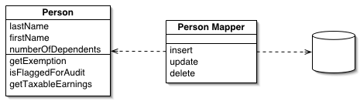
Pattern: Data Mapper
The Data Mapper is a layer of software that separates the in-memory objects from the database. Its responsibility is to transfer data between the two and also to isolate them from each other.
http://martinfowler.com/eaaCatalog/dataMapper.html
“A layer of Mappers that moves data between objects and a database while keeping them independent of each other and the mapper itself.”

Slide 13
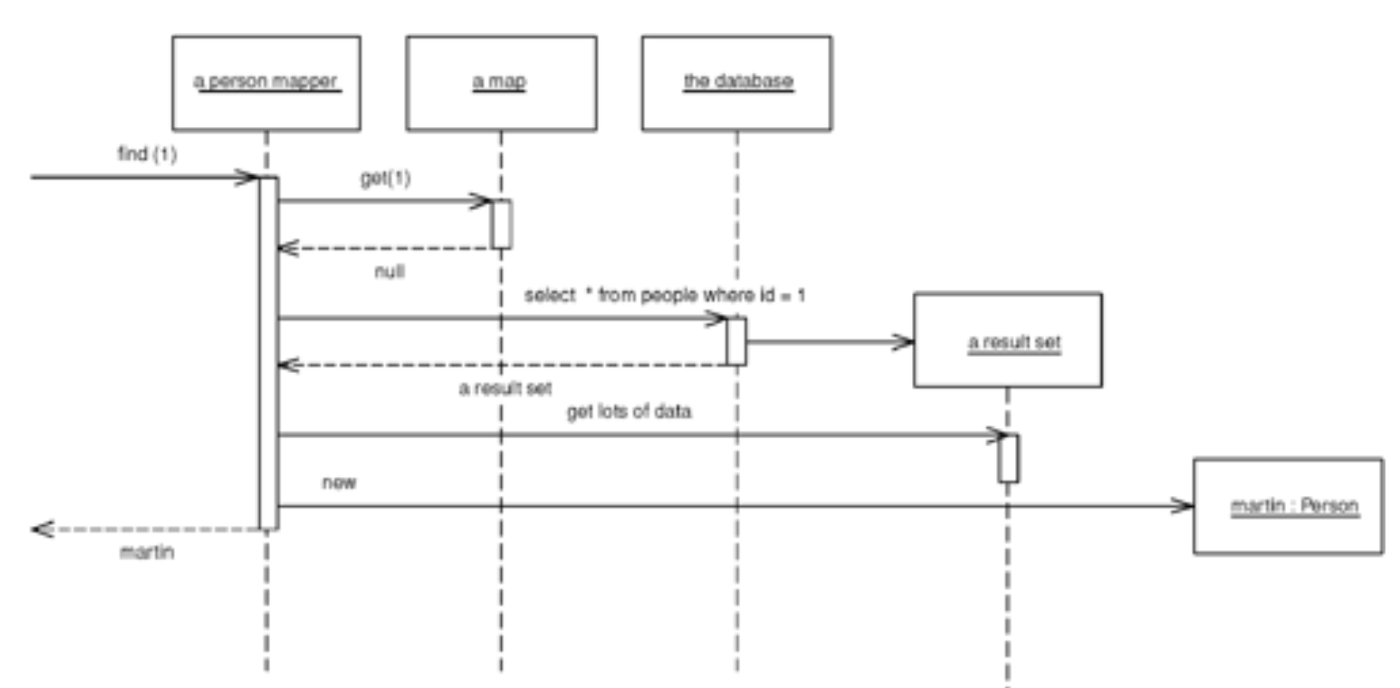
Data Mapper: Retrieving Data

Slide 14
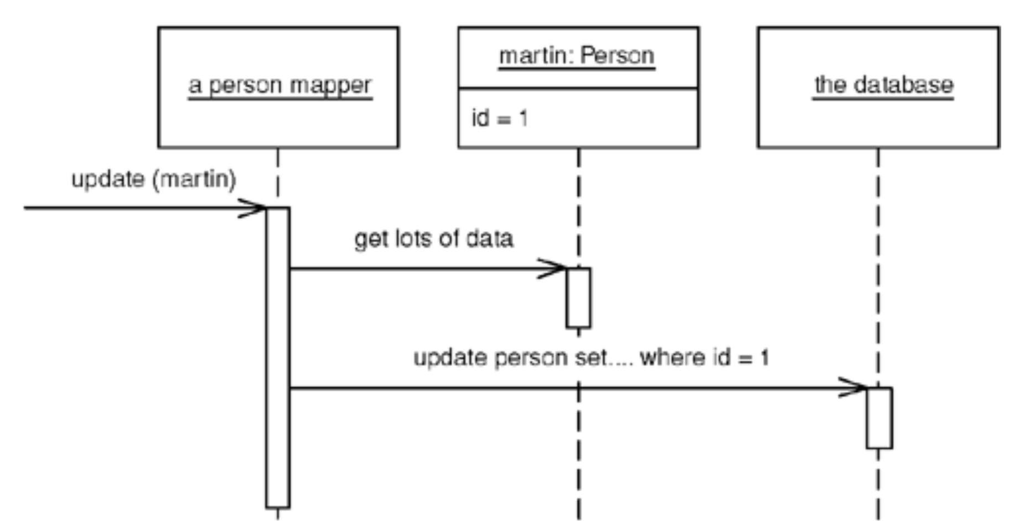
Data Mapper: Updating Data

Slide 15
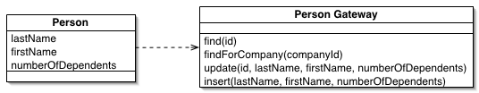
Table Data Gateway
A Table Data Gateway holds all the SQL for accessing a single table or view: selects, inserts, updates, and deletes. Other code calls its methods for all interaction with the database. A Table Data Gateway has one instance per table.
Notes:
Of the three patterns, Table Data Gateway is probably the most common.
The data access architecture patterns mention here come from Patterns of Enterprise Application Architecture, Fowler.
DAO is probably a better name because it suggests an interface onto any type of persistent store, not just relational. I’ll use the term Table Data Gateway because it is more consistent with other two patterns discussed.

Slide 16
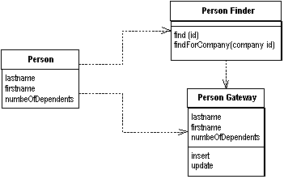
Row Data Gateway
Row Data Gateway gives you objects that look exactly like the record in your record structure but can be accessed with the regular mechanisms of your programming language. All details of data source access are hidden behind this interface. A Row Data Gateway has one instance per row returned by a query.

Slide 17
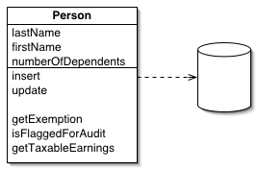
Active Record/Active DomainObject
An object that wraps a row in a database table, encapsulates the database access, and adds domain logic on that data.
Characteristics:
DomainObjects are dependent on the persistence mechanism
Use only if the DomainModel is simple enough and persistence mechanism does not change

Slide 18
JDBC: A Java Example
Implementing data source patterns

Slide 19
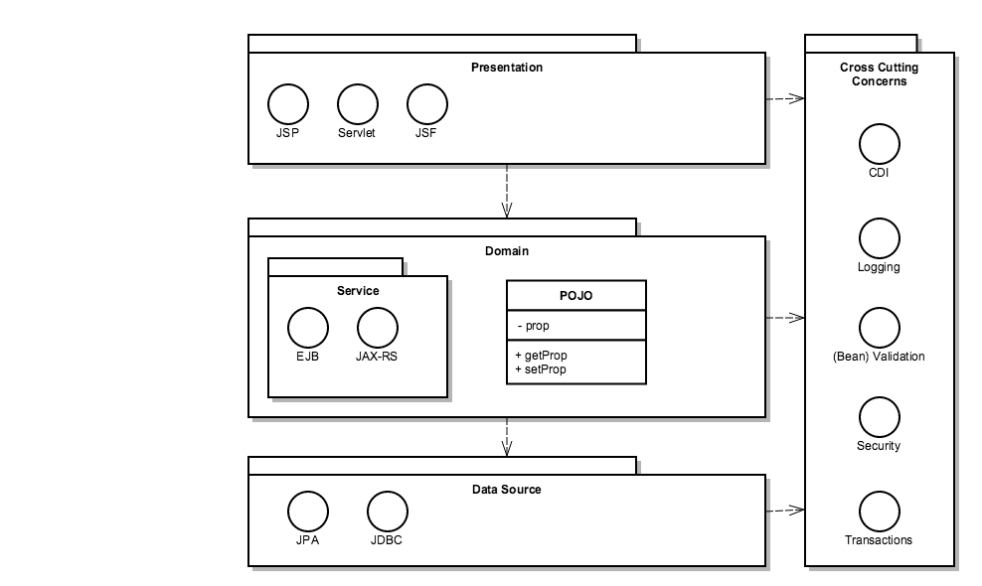
Java EE Platform architecture

Slide 20
JDBC: Java DataBase Connectivity
JDBC is a standard Java API for accessing relational data

Slide 21
JDBC Classes and Interfaces
JDBC is a set of standard Java classes and interfaces
Defined in the java.sql package
The JDBC interfaces specify a standard programming model, to access any RDBMS
<<interface>>
Connection
Create a Connection object, to connect to a particular database
<<interface>>
Statement
Create a Statement object, and execute it to fire off SQL against the database
<<interface>>
ResultSet
When you execute a SQL SELECT statement, the results are returned in a ResultSet object

Slide 22
JDBC Architecture
Each database vendor provides its own driver(s), to access a particular RDBMS
For example, there are JDBC drivers for MySQL, Oracle, Sybase, DB2, etc.
Each driver implements the aforementioned Java interfaces, to provide access to a particular RDBMS product
The java.sql package defines a class named DriverManager, to coordinate JDBC drivers
Use DriverManager to load a driver, and connect to a database

Slide 23
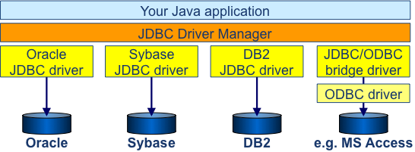
JDBC Architecture

Slide 24
Load JDBC Drivers
Each JDBC driver is a Java class
You must load this class into the JVM first, before you can connect to the database or execute any SQL statements
From JDBC 4.0 drivers are automatically loaded

Slide 25
Add JDBC driver to the classpath
We use Maven
Add dependency
<dependency> <groupId>mysql</groupId> <artifactId>mysql-connector-java</artifactId> <version>5.1.34</version> </dependency>

Slide 26
Connecting to a Database
Once you have loaded the JDBC driver, you can use DriverManager to open a connection to a database
Call DriverManager.getConnection()
JDBC uses URI syntax to denote database names
The URI syntax is "jdbc:<protocol>:DatabaseName"
For example, the following code connects to a database whose Data Source Name (DSN) is Employees
Database must exist and user must have appropriate access privileges.
Connection cnEmps = null;
try
{
cnEmps = DriverManager.getConnection("jdbc:mysql://localhost/Employees”, userID, password);
}
catch (SQLException e)
{
System.out.println("Error connecting to a database: " + e);
}
For now we use System.out.println. We’ll improve error handling soon.
Don’t put this stuff in sourcecode. Use property files instead.

Slide 27
Sidestep: Property files
In a Maven project put property files in src/main/resources
driver=com.mysql.jdbc.Driver
connectionString=jdbc:mysql://localhost/items?user=YOUR_USER&password=YOUR_PASSWORD
database.properties

Slide 28
Sidestep: Property files for test purposes
In a Maven project put property files in src/test/resources
H2 supports in memory databases!
driver=org.h2.Driver
connectionString=jdbc:h2:mem:simpleorder;DB_CLOSE_DELAY=-1
In memory database that is removed when the JVM exists
database.properties

Slide 29
Sidestep: Property files
Load properties from the classpath:
…
properties = new Properties(); properties.load(getClass().getClassLoader().getResourceAsStream("database.properties")); Class.forName(properties.getProperty("driver"));
…

Slide 30
Statements and Results
Representing SQL statements in JDBC
Executing a SELECT statement
Processing query results
Mapping SQL types to Java types
Executing INSERT, DELETE, and UPDATE statements
Using prepared statements
Handling output parameters and return values from a stored procedure
Using transactions

Slide 31
Representing SQL statements in JDBC
JDBC defines three separate interfaces, to enable you to execute SQL statements in various ways
<<interface>>
Statement
Use a Statement to execute any SQL statement (DML, DDL, and DCL are all allowed).
<<interface>>
PreparedStatement
Use a PreparedStatement to execute prepared (precompiled) SQL statements.
<<interface>>
CallableStatement
Use a CallableStatement to execute stored procedures. Some databases (e.g. Oracle) allow you to write stored procedures in Java.

Slide 32
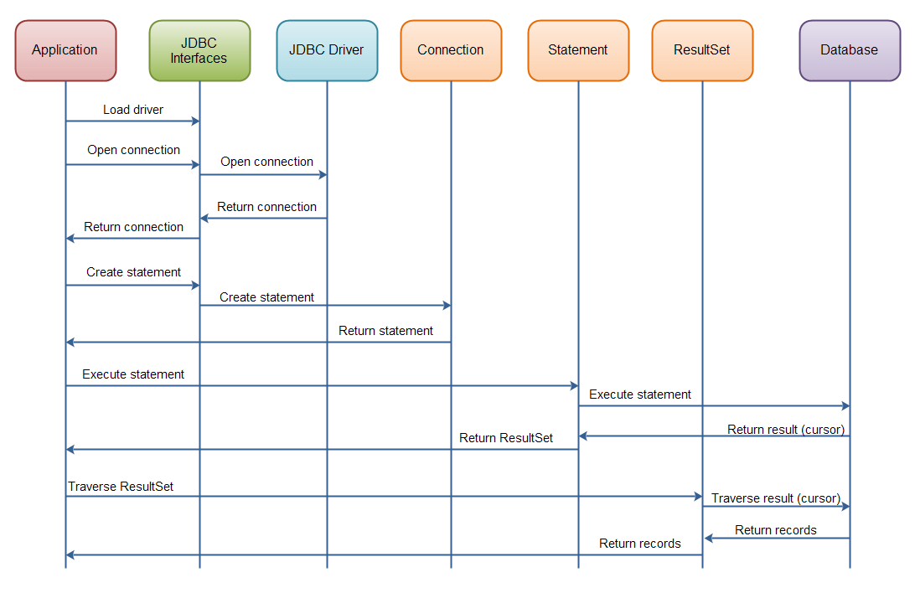
JDBC API Overview

Slide 33
Executing a SELECT Statement
You can use a PreparedStatement object to execute a SQL SELECT statement
This is the simplest and most common task in many Java apps
executeQuery() returns a ResultSet object. The ResultSet object holds the selected rows and columns
ResultSet rsEmps = null;
try
{
Statement st = cnEmps.prepareStatement("SELECT Name, Salary FROM Employees");
rsEmps = st.executeQuery();
}
catch (SQLException e)
{
System.out.println("Error executing query: " + e);
}

Slide 34
Processing Query Results
ResultSet has a suite of methods named getXxxx(), to get a column's value as a specific data type
Access columns by name
Statement st =
cnEmps.prepareStatement("SELECT Name,Salary FROM Employees");
ResultSet rsEmps = st.executeQuery();
while (rsEmps.next() != false)
{
String name = rsEmps.getString("Name");
BigDecimal salary = rsEmps.getBigDecimal("Salary");
}

Slide 35
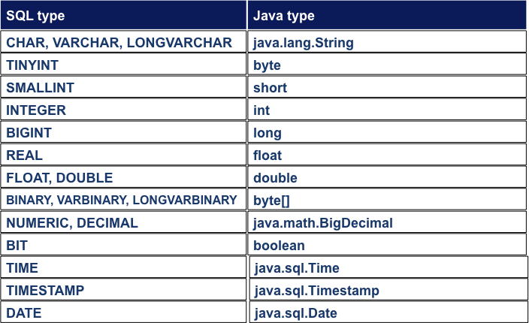
Mapping SQL Types to Java Types

Slide 36
Using Prepared Statements
It is also an effective way of preventing SQL Injections
A prepared statement is a statement whose SQL is only compiled the first time it is executed
Useful for optimization purposes, if you need to execute the same SQL statement several times with different parameters
PreparedStatement ps = cnEmps.prepareStatement(
"UPDATE Employees " +
"SET Salary = Salary * ? " +
"WHERE Region = ?" );
ps.setDouble(1, 1.25);
ps.setString(2, "Wales");
ps.executeUpdate();
ps.setDouble(1, 1.10);
ps.setString(2, "London");
ps.executeUpdate();

Slide 37
Getting Metadata for a Result Set
To obtain metadata for a particular result set, call the getMetaData() method on a ResultSet object
try
{
ResultSet rsEmps = st.executeQuery("SELECT * FROM Employees");
ResultSetMetaData rsmd = rsEmps.getMetaData();
int columnCount = rsmd.getColumnCount();
for (int i = 1; i <= columnCount; i++)
{
System.out.println("Col name: " + rsmd.getColumnName(i));
System.out.println("Type: " + rsmd.getColumnTypeName(i));
System.out.println("Nullable? " + rsmd.isNullable(i));
}
}
catch (SQLException e)
{
System.out.println("Error getting resultset metadata: " + e);
}

Slide 38
Summary
JDBC drivers and connections
JDBC is a standard API, for accessing data in any RDMBS
Load a JDBC driver, and use the driver manager to get a connection to a database
Statements and results
JDBC defines three statement-related interfaces: Statement, PreparedStatement, CallableStatement
Obtaining metadata
Call aConnection.getMetaData() to get database metadata
Call aResultSet.getMetaData() to get resultset metadata

Slide 39
Logging
More elegant error handling

Slide 40
Remember this?
ClassNotFoundException is a checked exception so we are required to catch it
What happens with all things printed to out?
try
{
Class.forName("com.mysql.jdbc.Driver");
}
catch (ClassNotFoundException e)
{
System.out.println("Error loading JDBC driver: " + e);
}

Slide 41
Java and streams
System has 3 public streams to access
System.in, to read from
System.out, to write normal stuff to
System.err, to write errors to
Every stream can be redirected/piped using
System.setIn(InputStream newIn)
System.setOut(PrintStream newOut)
System.setErr(PrintStream newErr)

Slide 42
Java Logging
Better control over
What and when to log (format, severities)
Where to log (file, database, webserver, etc.)
Log management (size, clearance, etc.)
Simple API
private Logger logger = Logger.getLogger(getClass().getName());
try
{
Class.forName("com.mysql.jdbc.Driver");
}
catch (ClassNotFoundException e)
{
logger.severe("Error loading JDBC driver: " + e);
}

Slide 43
Configuration
The Java Logging API can be configured in two ways:
Via a configuration class
JVM parameter java.util.logging.config.class
Via a configuration file.
default logging configuration file located at "lib/logging.properties”
setting the JVM property java.util.logging.config.file
Located in JRE folder, so applies for every application

Slide 44
What to configure
Handlers (e.g. ConsoleHandler, FileHandler, StreamHandler, SocketHandler, MemoryHandler)
Formatters (e.g. SimpleFormatter, XMLFormatter)
Levels (e.g. SEVERE, WARNING, INFO, CONFIG, FINE, FINER, FINEST)

Slide 45
Resources
http://tutorials.jenkov.com/jdbc/index.html
http://tutorials.jenkov.com/java-logging/index.html
https://github.com/arktekk/jcp/blob/master/Slides/Appendix%20A%20-%20Accessing%20Databases%20using%20JDBC.pptx?raw=true
Patterns of Enterprise Application Architecture, Fowler
Data Access Patterns: Database Interactions in Object-Oriented Applications, Nock

